Slide 1



Machine Learning Approach To The Prediction of Oil, Water and Gas Production In DSEATS Field
10/07/2024
NAME: EVANS UGHULU
SPE NUMBER: 5280891
SECTION: SPE BENIN SECTION
CATEGORY: STUDENT
COURSE OF STUDY: PETROLEUM ENGINEERING

Slide 2
Outline
01
Introduction
General overview…..
02
Exploratory Data Analysis
Table of Contents
Findings from exploration, DCA trends
03
Modelling using Neural Nets
Transformation, Training, Testing and Evaluation
04
Results
Estimation over history and forecast period
05
Conclusion
Vote of thanks.

Slide 3
Introduction
GENERAL OVERVIEW OF THE ENTIRE PROCESS
Importing necessary modules.
Loading the dataset.
Conversion of production date column to datatime64 object for easy manipulation.
Sorted the rows of data from earliest to latest.
Observation of data statistical distribution using “.describe” function.
Data Exploration.
Grouping wells by wellbore code.
Feature Engineering.
Grouping well production on a daily, monthly and annual basis.
Well Performance Plots.
Decline Curve Trends using linear regression.
Individual Well Modelling.
Evaluation of well models.
Well Production Forecasting.

Slide 4
EXPLORATORY DATA ANALYSIS
The data provided is a recorded production history of the DSEATS field over a period of 7.333 years (7 years, 4 months and 18 days).
This field contains five different production wells with wellbore codes 105, 106, 107, 108, and 109. Wells 107 and 108 are the oldest wells and have been producing for the highest number of days (2611 days each), while well 105 is the youngest well and has been producing for the least number of days.
From the data, I observed that there were days of zero production (i.e., no oil, water, or gas production). This could have resulted from wellbore shut-in periods to allow pressure buildup, downhole mechanical issues, well intervention measures that require well shut-ins, etc.
There was a total of 681 days (approximately 2 years) of Non-Productive Time (NPT), with well 108 having the highest number of NPT among the five wells (282 days).

Slide 5
Other Findings from the data
The DSEATS field produced 58.8263 MMstb of oil, 48.3274 Bscf of gas, and 79.5029 MMstb of water over the recorded period. Peak production occurred from early 2009 to early 2011, followed by a decline.
Well 107 was the highest oil producer with approximately 28 MMstb, followed by well 108 with about 24 MMstb. Both wells also had the highest water production, with well 107 producing 40 MMstb and well 108 producing 37 MMstb, along with the most gas.
High water production can be mitigated by changing choke size, reperforating above the water-oil contact (WOC), or further wellbore shut-ins to allow equilibrium.
Histograms are shown below.

Slide 6
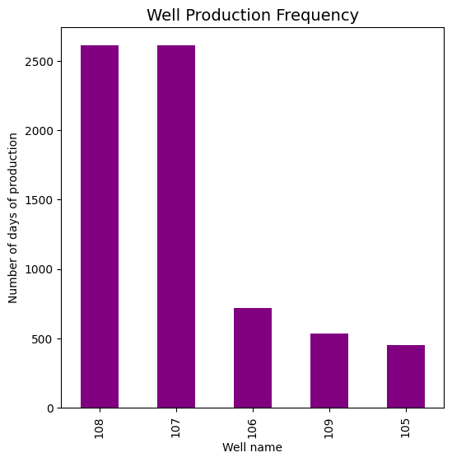
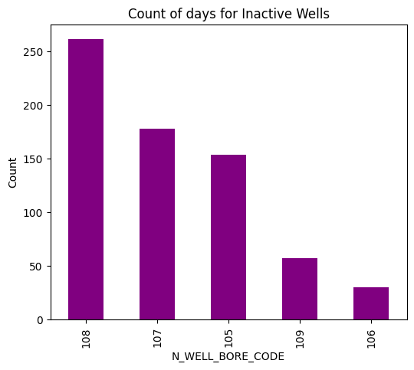
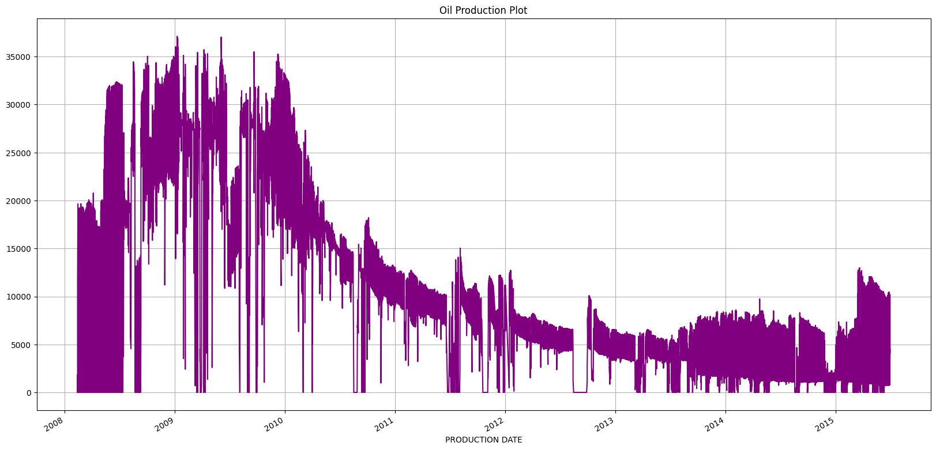
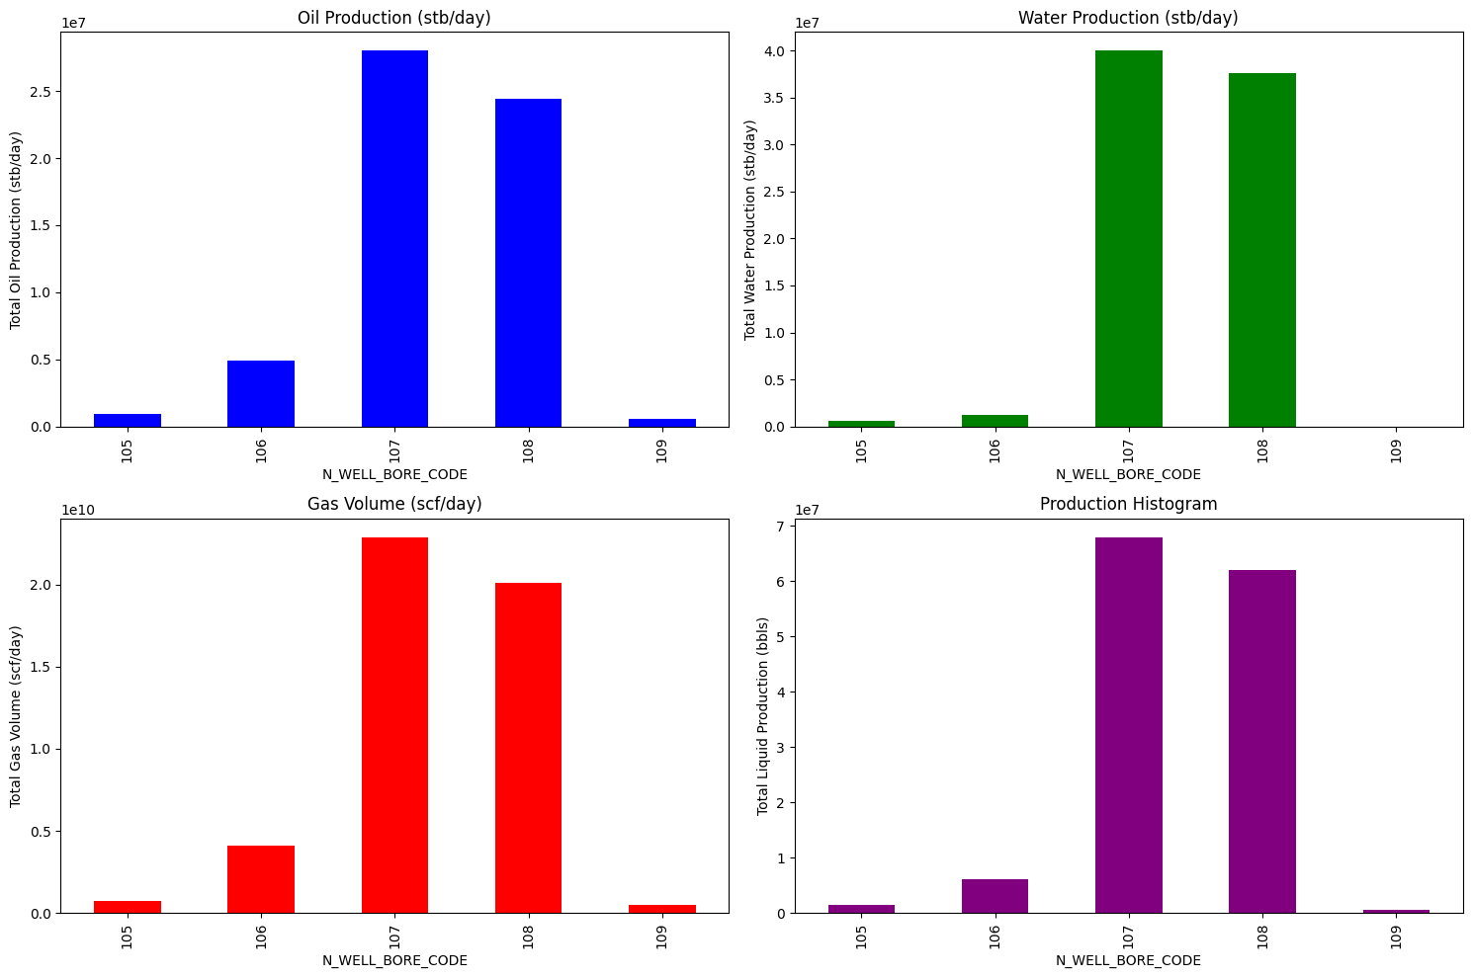
Analysis Plots

Slide 7
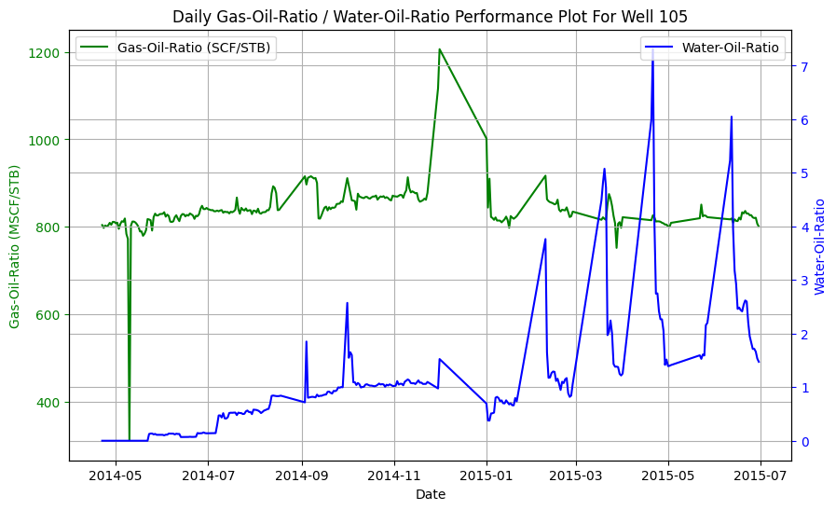
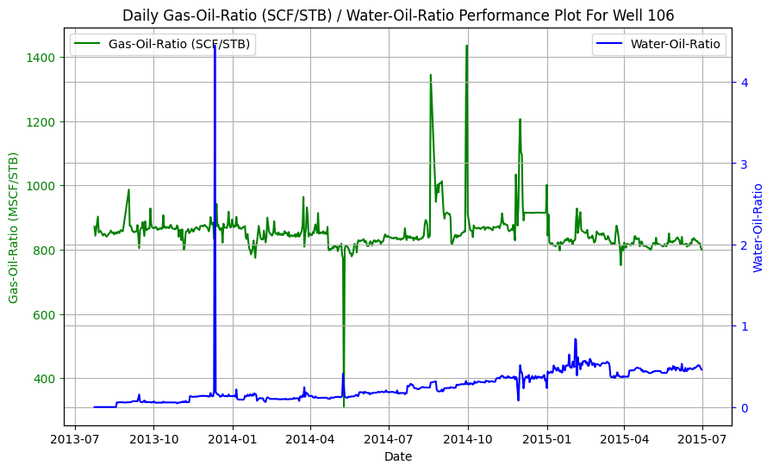
Well Performance Plots
In the attached ipynb file is included the reservoir performance plots for each well (WOR, GOR, Downhole pressure, oil production, cumulative oil production, liquid production)
Samples of the plots are shown above, it can be seen that each well has it distinct characteristic throughout the production history even though they are producing from the same DSEATS field.
It would be unrealistic to model the field as a whole given this fact.
Hence, all wells were modelled individually to account for their distinct character.

Slide 8
MODELLING PROCESS
This process involved the transformation of the dataset using different techniques to reduce the level of skewness and make the data normally distributed.
Feature engineering using Pearson’s correlation coefficient revealed that choke size is one of the most important features in predicting production. Choke size is also used in controlling the average wellhead pressure (AVG WHP).
Feedforward neural networks using TensorFlow were used to train and test the model for each well after scaling and splitting. This approach was chosen mostly due to the flexibility of these networks and their ability to learn patterns even in the presence of outliers or noise.
Log or sqrt Transformation
Scaling and Splitting
Training and testing using neural nets

Slide 9
Models Evaluation: Results Table
WELL BORE CODE | Production | R-Squared (%) | RMSE | MAE
105 | Oil Production | 91 | 0.3 | 0.22(MSTB)
 | Gas Production | 91 | 0.29 | 0.19(MMSCF)
 | Water Production | 94 | 0.28 | 0.3(MSTB)
106 | Oil Production | 91 | 0.69 | 0.51(MSTB)
 | Gas Production | 89 | 0.73 | 0.43(MMSCF)
 | Water Production | 97 | 0.29 | 0.11(MSTB)
107 | Oil Production | 93 | 3.12 | 1.30(MSTB)
 | Gas Production | 92 | 2.40 | 1.07(MMSCF)
 | Water Production | 92 | 3.75 | 1.69(MSTB)
108 | Oil Production | 91 | 2.70 | 1.28(MSTB)
 | Gas Production | 89 | 2.16 | 1.08(MMSCF)
 | Water Production | 90 | 2.83 | 1.57(MSTB)
109 | Oil Production | 71 | 0.01 | 0.05(MSTB)
 | Gas Production | 73 | 0.01 | 0.05(MMSCF)
 | Water Production | 71 | 0.00 | 0.00(MSTB)

Slide 10
Results Contd
The total historical oil production for DSEATS field: 58.8263 MMstb of oil
The total historical gas production for DSEATS field: 48.3274 Bscf of gas
The total historical water production for DSEATS field: 79.5029 MMstb of water
Total Forecasted Oil production for the DSEATS field: 13.4167MMstb of oil
Total Forecasted Water production for the DSEATS field: 11.036Bscf of gas
Total Forecasted Gas production for the DSEATS field: 16.622MMstb of water
Thank You.

